Slide 1
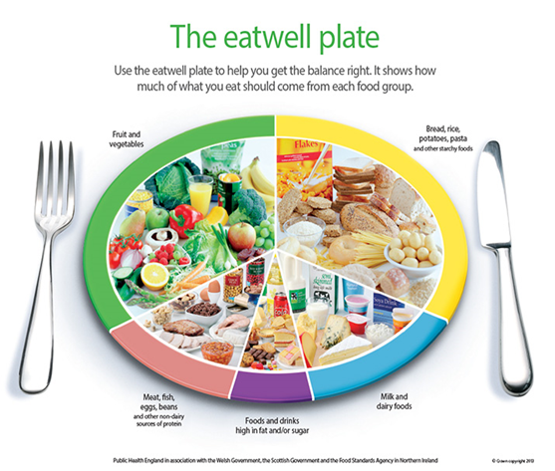
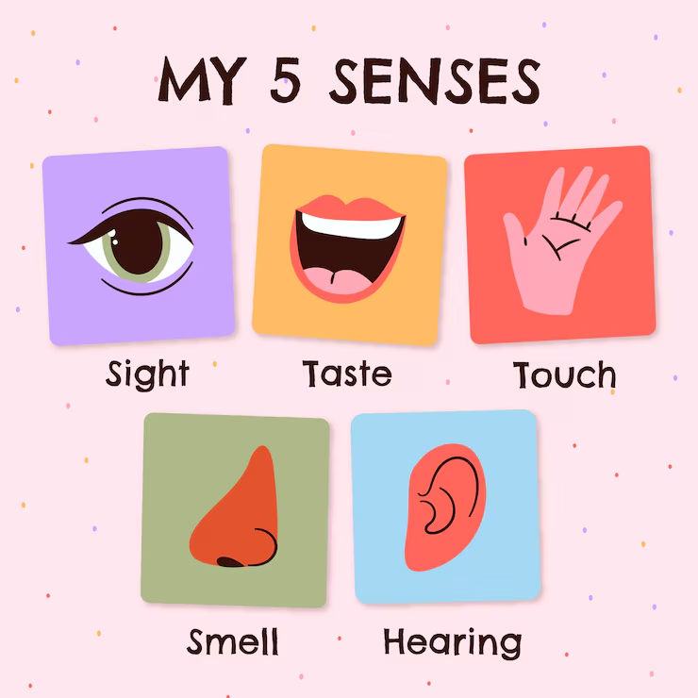
Year Group: 1 / 2 Term: Autumn Topic: Animals including Humans
Key Vocabulary
Adult | A fully grown animal or plant.
Baby | A very young child.
Toddler | A young child who is just beginning to walk.
Child | A young human.
Teenager | A person aged between 13 and 19 years.
Develop | To grow or become more mature, and advanced.
Lifecycle | Changes living things go through.
Offspring | The child of an animal.
Survival | Continuing to live or exist.
Basic needs | The essential things needed to survive including food and water.
Nutrition | Food needed to live.
Hygiene | How clean something is.
Exercise | Physical activity to keep the body fit.
Diet | The usual food and drink of a person or animal.
Sticky Knowledge
Living things are those that are alive.
Dead things are those that were once living but are no longer.
Some things have never been alive.
Animals need water, food, air and shelter to survive. Their habitat must provide all these things.
A healthy lifestyle includes exercise, good hygiene and a balanced diet.
Animals, including humans, have offspring which grow into adults. In humans and some animals, these offspring will be young, that grow into adults. In other animals, there may be eggs laid that hatch to young or other stages which then grow to adults. The young of some animals do not look like their parents.
Good hygiene is also important in preventing infections and illnesses.
We get information about the world around us by using our five senses.
Key Questions
Can they describe what animals need to survive?
Can they explain that animals grow and reproduce?
Can they explain why animals have offspring which grow into adults?
Can they describe the life cycle of some living things?
Can they explain the basic needs of animals, including humans for survival?
Can they describe why exercise, balanced diet and hygiene are important for humans?
Do they know the basic stages in a life cycle for animals, (including humans)?
Do they know why exercise, a balanced diet and good hygiene are important for humans?
Can they explain that animals reproduce in different ways?

Slide 2
Year Group: 1 / 2 Term: Autumn Topic: Animals including Humans
Prior Vocabulary
Wild animal | An undomesticated animal that lives in the wild.
Pet | A domesticated animal that lives in our homes.
Farm animal | An animal that is kept for food or clothing.
Senses | Five physical abilities to see, hear, smell, taste, and feel.
Face | The front of the head, where the eyes, nose, and mouth are.
Body | The whole physical structure that forms a person or animal
Teeth | One of the hard, white objects in the mouth that are used for biting and chewing.
Prior Knowledge
In PE children will know the importance of exercise on a healthy body.
They may also have made a healthy sandwich in food technology.
Children will have identified and named a variety of common animals that are carnivores, herbivores and omnivores.
Children will have identified, named, drawn and labelled the basic parts of the human body and say which part of the body is associated with each sense.
Future Learning
Identify that animals, including humans, need the right types and amount of nutrition, and that they cannot make their own food; they get nutrition from what they eat.
Describe the differences in the life cycles of a mammal, an amphibian, an insect and a bird.
Describe the life process of reproduction in some plants and animals.
Recognise the impact of diet, exercise, drugs and lifestyle on the way their bodies function.

