Slide 1
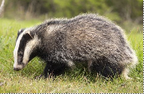
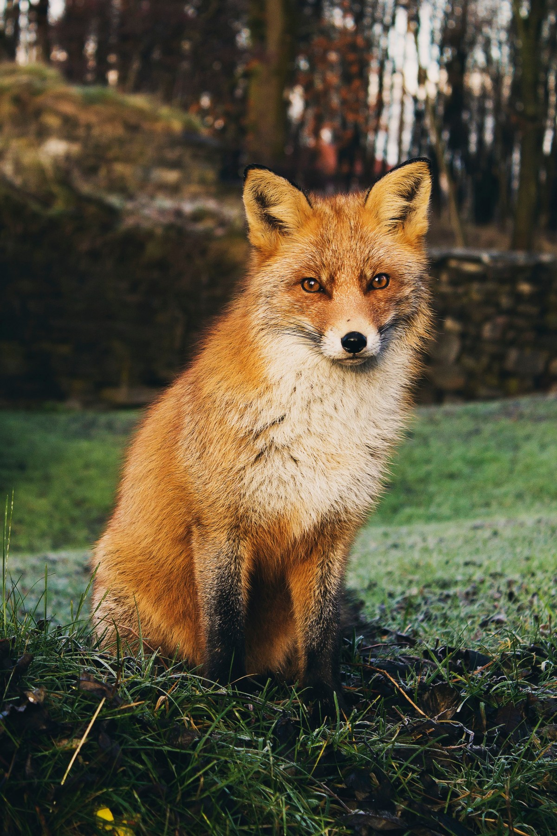
Year Group Reception Term Summer Topic: The land outdoors
Key Vocabulary
1 | Habitat | The place in which an animal or plant lives.
2 | Young | A baby animal. E.g. calf, lamb, cub.
3 | Character | A person or animal in a story.
4 | Nocturnal | Animals that wake up at night and sleep in the day
5 | Predator | An animal that preys on others
6 | Camouflage & language related to pattern/colour | Hide to blend in with surroundings
7 | Language related to movement | e.g flap slither
8 | Life cycle | the series of changes in the life of an animal including reproduction.
9 | Farmer | A person who owns or manages a farm, raising animals or growing plants for food or materials.
10 | Endangered | there are very few of those animals left on the planet and that if we don’t help them in some way that they are at risk of being extinct which means disappearing forever
Sticky Knowledge
1 | All animals are living creatures with their own feelings How we have a responsibility to look after the animals on our planet
2 | Animals have life cycles
3 | There are a wide variety of animals with different appearances, movements, behaviours and habitats (though we will focus on our local habitat) Endangered animals locally.
4 | Some animals are carnivores and some are herbivores
5 | Some animals wake up at night and sleep in the day
6 | Animals inhabit different kinds of habitats Endangered animals locally.
7 8 | David Attenborough is a natural historian, writer, broadcaster and filmmaker. Animals – how they move/ sound/ what they eat
Key Questions
1 | Where do different animals live? Can you describe their natural habitats?
2 | Why are there so many animals in traditional tales?
3 | Why do animals inhabit different kinds of habitats
4 | What patterns or colours can we see on animals? Why do animals have these?
5 | Which animals make good pets and why? Which animals do not make good pets and why?
6 | Can I name animals that live in our habitat at school?
 | What can we do to help endangered animals in our local and wider habitat?

