Slide 1
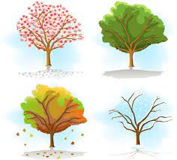
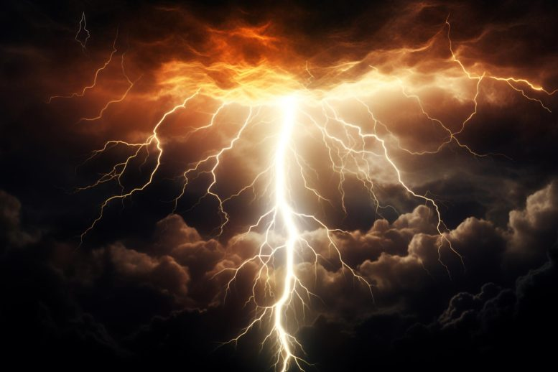
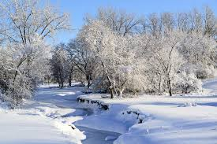
Bramley Class Spring Term Seasonal Changes
Key Vocabulary
Climate | The usual weather conditions in a place
evergreen | A plant with green leaves that stay
deciduous | A plant that loses leaves every year
blossom | The flower of a plant
month | One of the twelve parts of the year
Force | Power, energy or strength
daylight | The light of day
temperature | The measurement of heat or cold
Sticky Knowledge
Different types of weather include sun, rain, hail, wind, snow, fog, lightning, storm and cloud.
The weather can change daily and some weather types are more common in certain seasons, such as snow in winter
Simple equipment can be used for measuring weather, such as measuring temperature with a thermometer; identifying wind direction and force with a wind sock or measuring rainfall with a gauge.
Observe and describe how day length changes across the year.
Day length (the number of daylight hours) is longer in the summer months and shorter in the winter months
Key Questions
1 | How is the weather different for each season?
2 | How does the temperature change during each season?
3 | What causes the seasons?
4 | Are seasons the same all over the world?
5 | Why do plants change with different seasons?
6 | How do seasons affect animals?
7 | Why do the lengths of days change with different seasons?

Slide 2
Prior Vocabulary
Day | The time between sunrise and sunset
Night | The time between sunset and sunrise
Weather | The conditions outside in a certain place and at a certain time
Colder | Without heat
Warmer | With heat
Seasons – Spring Summer Autumn Winter | One of the four parts of the year
Prior Knowledge
In autumn leaves fall from the trees, In winter it’s colder, In summer it’s warmer and flowers may grow in spring.
Each season has typical weather patterns. Types of weather include sun, rain, wind, snow, fog, hail and sleet.
At night it is dark, in the day it is light. In winter it is colder, in summer it is warmer
There are four different forms of light pollution that vary over the seasons.
Future Learning
Use the idea of the Earth’s rotation to explain day and night and the apparent movement of the sun across the sky.
Science Investigation Skills Focus
 | Identifying, grouping and classifying
 | Observations over time
 | Comparative / fair testing

