Slide 1
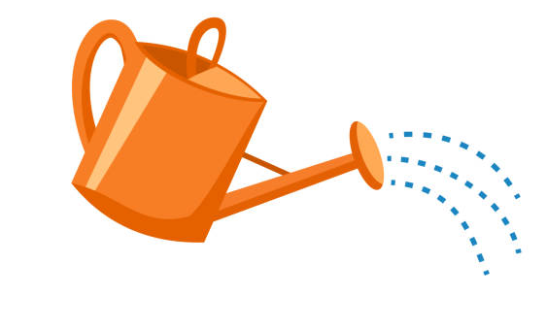
Science - Year Group: 1 / 2 Term: Summer Topic: Plants
Key Vocabulary
bulb | A plant bud that begins to grow underground.
bud | A part of a plant that can grow into a new plant.
blossom | The flower of a plant that grows into a seed or fruit.
classify | To group or order things.
embryo | A plant that is starting to develop.
food Store | Where food is stored to give the embryo energy to germinate.
germination | When something starts growing.
observe | To watch closely.
pesticide | A pesticide is a solution created to stop pests and diseases that attack plants.
pollen | Yellow powder made by a flowering plant.
seed coat | The outer covering of a seed.
tunic | A papery outer covering.
Sticky Knowledge
To know that seeds and bulbs grow into mature plants.
Plants need water, light, nutrients, space and a suitable temperature to grow and stay healthy.
As the plant grows bigger, it develops leaves and flowers.
Different seeds and bulbs grow into different plants.
Plants may have flowers which then develop into seeds, berries or fruit.
Plants can be eaten by pests. Humans use pesticides to control the pests but some of the pesticides are harmful to nature.
Key Questions
What are the different parts of seeds and bulbs?
How can different seeds and bulbs be classified?
Are all seeds and bulbs the same?
What can we do to encourage plants to grow well?
How do plants change as they grow?

