Slide 1
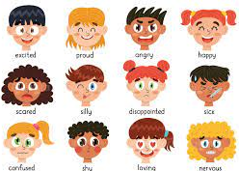
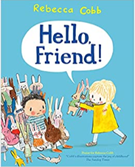
Year Group Reception Term Autumn Topic: You’ve got a friend in me!
Sticky Knowledge
Some people are different to me.
People feel different emotions.
Family and friends are people who are important to me.
Different events have happened in the lives of my family and friends.
Everybody has the right to learn and play safely and happily.
Different people in my family have different responsibilities.
Sometime people fall out with each other.
Unkind words can hurt people and can never be taken back.
Friendships can be mended in different ways.
A human face includes features, such as eyes, nose, mouth, ears and hair.
There are many different ways to create portraits of friends and family.
Key Vocabulary
portrait
emotion
friendship
events
change
kind
gentle
friend
similarities
differences
rights
responsibilities
turn taking
Key Questions
What is a good friend?
What thing make us feel different emotions?
How can we control our emotions?
How are we different?
How do my friends, family and I change?
What can I say to people to make them feel better?

Slide 2
Year Group Reception Term Autumn Topic: You’ve Got a Friend in me!
Prior Knowledge
We can all talk about our families.
How are our families different?
We all like different things.
We need to use kind hands when we work and play.
I grow bigger as I get older.
Different people in our community keep us safe.
Different things make us happy and sad.
Previous Vocabulary
happy
sad
angry
scared
friend
family
mummy
daddy
sister
brother
grandmother
grandfather
feelings
Future Learning –
Know that families are founded on belonging, love and care
Know that physical contact can be used as a greeting
Know how to make a friend
Know who to ask for help in the school community
Know that there are lots of different types of families
Know the characteristics of healthy and safe friends
Know about the different people in the school community and how they help

